Slide 1
IoT Summer School Day 1 Abstracts
James Brusey

Slide 2
Overview for afternoon
Seven simple suggestions for improving your writing
Abstracts
Presenting

Slide 3
for the next video ...
note down each of the simple suggestions as they are given

Slide 4
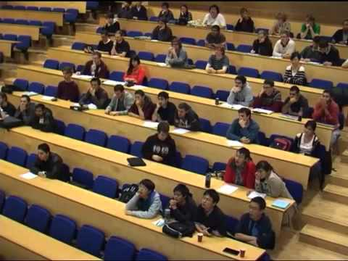
seven simple suggestions
Notes:
finish by 12.30

Slide 5
discussion
which suggestions did you find most surprising or inspirational?

Slide 6
pomodoro technique
www.pomodorotechnique.com

Slide 7
‘shut-up-and-write’!
https://thesiswhisperer.com/shut-up-and-write/

Slide 8
exercise (10 minutes)
Come up with a research topic¹
Put it here
You can write down the title for your research topic plus one research question that your paper will answer
¹ Zobel p267 ex 1
Notes:
1:30 - 1:45

Slide 9
abstracts
See Mike Ashby’s how to write a paper: http://goo.gl/8Ibmf0
Find the section on how to write an abstract

Slide 10
exercise (1 pomodoro)
underneath your title, write a draft abstract applying the rules from Ashby (<= 3 sentences for each of Intro; Method; Results; Conclusions)
Notes:
11:30 finish

Slide 11
review
Selecting one or two of the abstracts at random
can we understand it?
is it concise?
Things to watch for (and avoid):
vague statements about how interesting the subject is becoming
skipping elements (e.g. no statement about method)
hyperbole
Notes:
12:00 finish

Slide 12
what we didn’t cover in this session
grammar
punctuation
spelling
and many other things about good writing …
… but please see the further reading

Slide 13
further reading
Zobel’s “Writing for Computer Science”
Elements of Style - Strunk and White
Coursera - Writing in the Sciences
http://libweb.surrey.ac.uk/library/skills/writing%20Skills%20Leicester/index.php
and many others!

Slide 14
Presenting

Slide 15
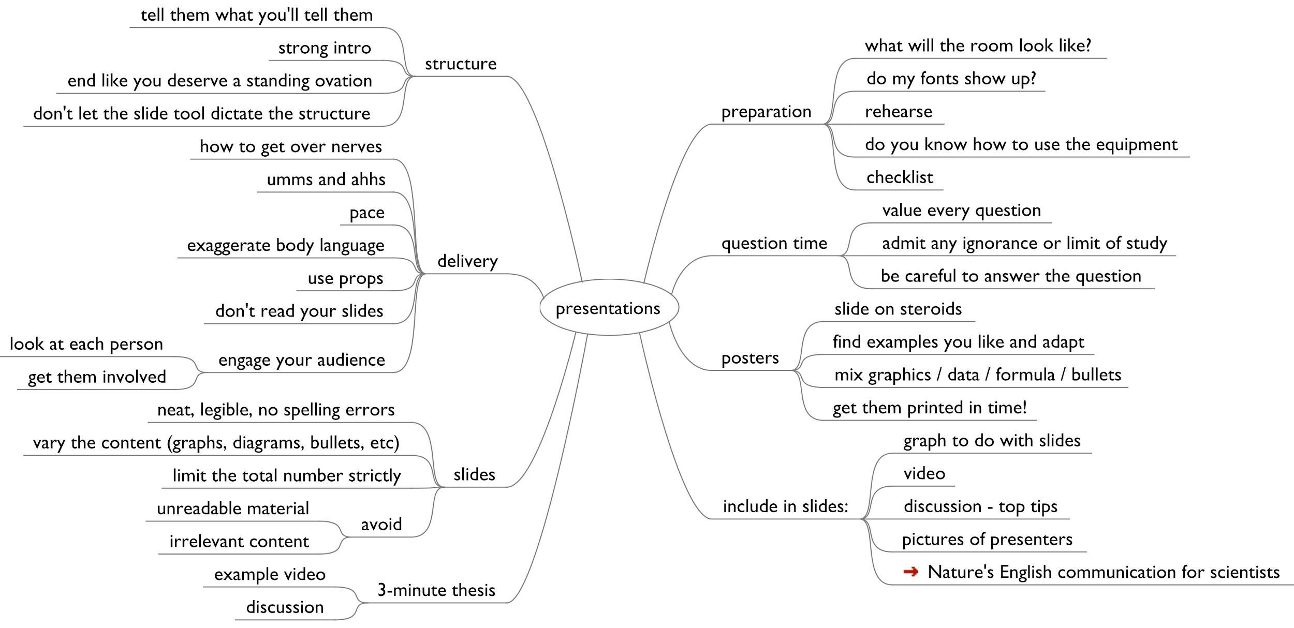

Slide 16
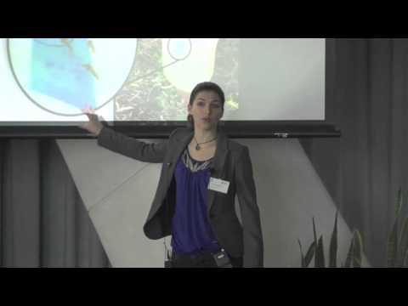
Three Minute Thesis (3MT)

